Slide 1

FLIPROBO TECHNOLOGIES
House Price Prediction
Submitted by:- Neelesh Saini

Slide 2
PROBLEM STATEMENT
Houses are one of the necessary need of each and every person around the globe and therefore housing and real estate market is one of the markets which is one of the major contributors in the world’s economy. It is a very large market and there are various companies working in the domain. Data science comes as a very important tool to solve problems in the domain to help the companies increase their overall revenue, profits, improving their marketing strategies and focusing on changing trends in house sales and purchases. Predictive modelling, Market mix modelling, recommendation systems are some of the machine learning techniques used for achieving the business goals for housing companies. Our problem is related to one such housing company.

Slide 3
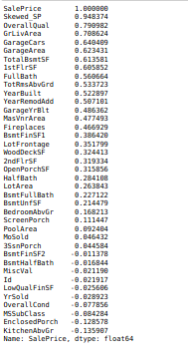
Analytical Problem Framing
The correlation of Sale price with all the other variables is given above.
There are lots of variable which are highly correlated with the sale Price.

Slide 4
Data Preprocessing
We treated the skewness using Log transformation.
We imputed the missing values.
We encoded the categorical values using One hot encoding
We trained the model on the train set
We tested the model on test set
Applied hyperparameters for improving the performance.

Slide 5
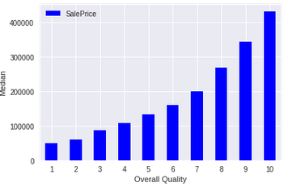
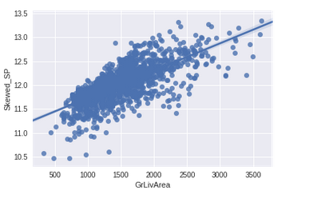
Visualisation
SalePrice varies directly with the Overall quality
SalePrice increases as the GrLivArea increases. We will also get rid of the outliers which
severely affect the prediction of the survival rate.

Slide 6
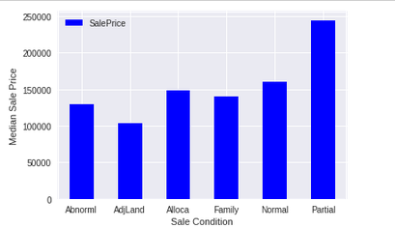
Model/s Development and Evaluation
Identification of possible problem-solving approaches (methods)
The Sale price is highly affected by sale condition.

Slide 7
Model Development
Testing of Identified Approaches (Algorithms)
Linear Regression
Random forest Regressor
Lasso Regressor
Ridge Regressor
Gradient Boost Regressor

Slide 8
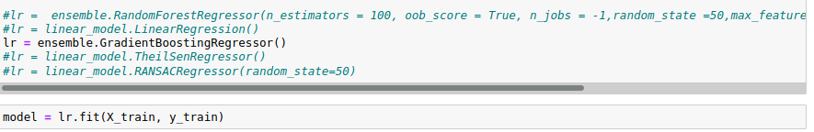
Evaluating different models
The metrices used for evaluation are
R2 Score
Root mean square error

Slide 9


Model Evaluation
So from the above Images we can see that Gradient Boost Regressor is the best performing model.

Slide 10
CONCLUSION
Key Findings and Conclusions of the Study
From the visualisation and model building we analysed that Gradient boost regressor performed better when this type of dataset was given and based on the model performance it can be used to predict the house price of the house based on various factors.
Based on the final model the Real estate company can make decisions and
there is a higher possibility that the decisions will be profitable

Slide 11
Thank You

